Slide 1
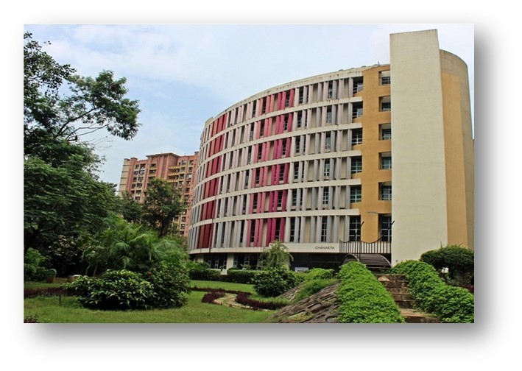
MBA Healthcare Management (HCM) Batch 2021-23 Two Year Full Time Multi Disciplinary & Super- Specialization Programme in Healthcare Management

Slide 2
Growth in Indian Healthcare Sector
Healthcare industry in India comprises of hospitals, pharmaceutical companies, medical devices, clinical trials, outsourcing, telemedicine, medical tourism, health insurance and medical equipment, wellness and fitness, etc.
The industry is growing at a tremendous pace owing to rising incomes, rising awareness, rising adoption of new technologies and increasing expenditure by public as well as private players.
Healthcare sector in India – US $372 Billion by 2022
Hospital sector – US $ 160 Billion
Health insurance sector growing by 24 % per annum
Indian pharmaceutical industry growing by 15 % per annum
Medical tourism rising by 18 % per annum

Slide 3
Peculiar Features of Indian Healthcare Sector
Healthcare sector expanding at a great speed – vertical and horizontal growth
Change in consumer behaviour – adaptation of technology, awareness related to wellness and fitness
High level of digitalization
Emergence of new technologies such as IoT, AI, Robotics
Public healthcare spend is likely to grow to 2.5 % of the GDP
Ayushman Bharat Pradhan Mantri Jan Arogya Yojana (PM-JAY) can be game changer in the healthcare sector
Vibrant and robust private health sector accounting for 74 % of the market share
Opportunities for Health Tech start-up companies

Slide 4
Programme Highlights of MBA HCM
Two year full time programme
Super specialization in Healthcare area
Good blend of Management and Domain specific subjects
Covers the healthcare sector holistically
High focus on experiential learning
Good opportunity to do internship abroad with a reputed institutions

Slide 5
Our Collaborators
1. Academic collaboration with Imperial College Health Partners, UK: 9th in the World – The Times Higher Education World University Rankings 2020
2. Academic partnership with K.J. Somaiya Hospital & Research Centre, Mumbai and other international institutions
3. Wipro – GE Healthcare India Ltd– Collaboration to deliver the academic module and industrial visit to its Bangalore campus along with certification
4. KPMG International – Six Sigma Certification

Slide 6
Specific Objectives of the Programme:
To enable students with requisite competencies to take the advantages of growing healthcare sector
To equip students with relevant managerial and technical skills to tackle the challenges faced by healthcare industry
To provide a holistic understanding of global healthcare sector and Indian healthcare sector in particular
To update their knowledge about changing business environment in healthcare sector and help them apply different management techniques at the organizational level
To develop fundamental concepts related to managing finance, human resources, marketing, operations and entrepreneurial opportunities in healthcare sector.

Slide 7
Focus of the Programme
The programme looks at healthcare in a holistic manner.
It includes hospital sector, pharmaceutical sector, medical services, medical equipment, medical insurance, wellness and fitness, diagnostic services, etc.
The programme focuses on giving experiential learning through various ways such as concurrent projects, field visits, guest speakers and higher involvement of the experts from the sector in designing curriculum and delivery of the domain specific subjects.
It will also focus on emerging areas such as data analytics, digital healthcare, wellness & fitness as well as new business opportunities.

Slide 8
Unique Advantages of K J Somaiya Institute of Management
The institute’s geographical presence in Mumbai – presence of all the sectors covered under healthcare industry.
Collaboration with Imperial College Health Partners, UK
Academic partnership with K. J. Somaiya Hospital & Research Centre, Mumbai and other renowned institutions.
High focus on Experiential Learning
Very good opportunity for International Immersion Program.
Excellent Profile of Board of Studies
Academic collaboration with Wipro GE Healthcare India

Slide 9
Board of Studies
1. Vice Chancellor, SVU - Prof (Dr ) V N Rajasekharan Pillai
2. Dr Monica Khanna - Director - K J SIM
3 Dr Pramod Prabhakaran - International Business Development and Partnerships - Imperial College Health Partners, London, UK
4. Dr Alex Lewis - Medical Director, E & Y, London, England, UK
5. Dr Srijith Nalinakshan - CEO - K J Somaiya Hospital and Research Centre
6. Jamshyd Patravala - Healthcare Business Leader, Singapore, Alumnus (1991-93)

Slide 10
Board of Studies
7. Dr Kapil Raina - Director, Worldwide Commercial Lead (Head and Neck Cancer & Glioblastoma) at Bristol-Myers Squibb, USA ( our alumnus from PGDM 2003-05 )
8. Mr Chinmay Gheewala - CoFounder - Director at Nityacare Health Technologies Pvt Ltd., Director at MedCash HealthTech Pvt Ltd– Alumnus MMS 1999-2001
9. Sachin Parekh - VP - Operations at Neosap EdTech, Alumnus MMS 2000-2002
10. Dr Prema Basargekar - Programme Coordinator PGDM Healthcare
11. Dr Poonam Chauhan - Programme Co- coordinator - PGDM Healthcare
12. Dr. Jaya Mathew – Programme Co-coordinator – PGDM Healthcare

Slide 11
Learning Methodology
Emphasis on achieving learning outcomes.
Use of diverse tools such as case studies, role play, film analysis, guest lecture, simulation, etc.
Emphasis on peer learning and interactive teaching – learning.
Institute has subscribed Harvard case studies and online research data base to encourage research.
Industry internship is compulsory.
Master’s thesis in the second year to encourage research
Scope for live projects

Slide 12
Unique Offerings
Design Thinking Workshop:
The students undergo Design Thinking workshop which is ‘empathy’ based tool to create new ideas.
2. Product and New Business Development:
The programme has a tie-up with Wipro GE Healthcare India to deliver the module and to take the MBA HCM students for industrial immersion to visit GE’s Bangalore Research and Manufacturing site
3. Six Sigma in Healthcare:
It is a core part of the syllabus. Students also receive Six Sigma Healthcare Certificate from a reputed organization

Slide 13
Healthcare Management - Programme Learning Goals
General Learning Goals of MBA programme:
Management Knowledge
Critical Thinking
Communication Skills
Global Awareness
Team Orientation
Ethical Responsibility
The stated Learning Goals other than General MBA learning goals for the programme are as follows:
1. Integrative Thinking in Healthcare Management
2. Decision Making though Application of Information and Data Analytics
The course structure and the syllabus is developed in tune to achieve these competencies in the students by the end of the second year.

Slide 14
Eminent Visiting Faculty from Healthcare sector
We have 50 % of the subjects taught by the visiting faculty from healthcare sector. Few of them are listed below:
1. Dr Neil Sequeira - Vice President - Human Resources and Administration, Kokilaben Dhirubhai Ambani Hospital
2. Mr. Jagdeep Sharma – Founder & Director, Dr Anushka Super Speciality Eye Hospital
3. Mr. Lalit Dabholkar – Founder Director – Aurigo Consulting & Research LLP
4. Mr. Sachin Parekh – VP – Ops, Neosap EdTech
5. Mr. Prashant Laghate – Associate Director, Merck

Slide 15
Eminent Visiting Faculty from Healthcare Sector
6. Mr. Guruprasad Rao – Director, Imaginerium (I) Pvt. Ltd
7. Dr Sanjay Dalsania – Regional Quality Head, Apollo Hospitals
8. Ms. Anagha Shirur – Associate Marketing Manager, Novartis
9. Dr Mukund Kulkarni – Advisor, Healthcare & Insurance
10. Dr Mangesh Pednekar – Director, Healis Sekhsaria Institute for public Health
11. Mr. Sanjay Bhatia – Partner – NextPlan
12. Mr. Tarun Dev – Healthcare Consultant

Slide 16
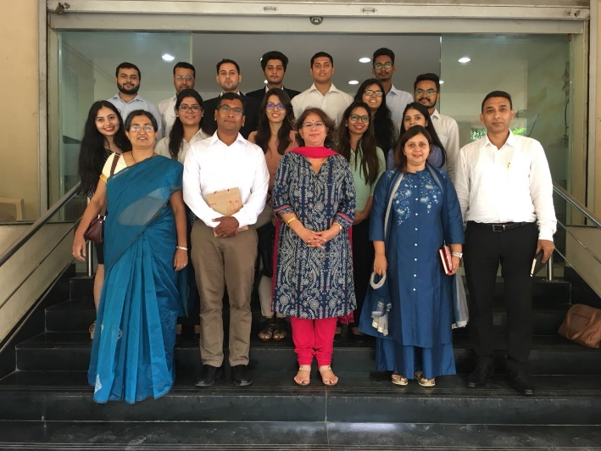
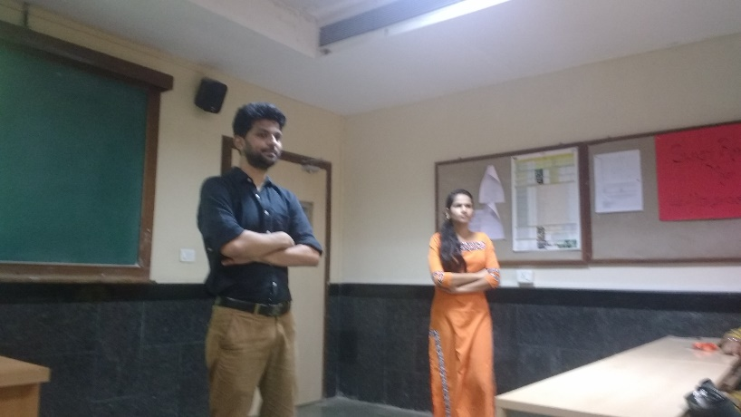
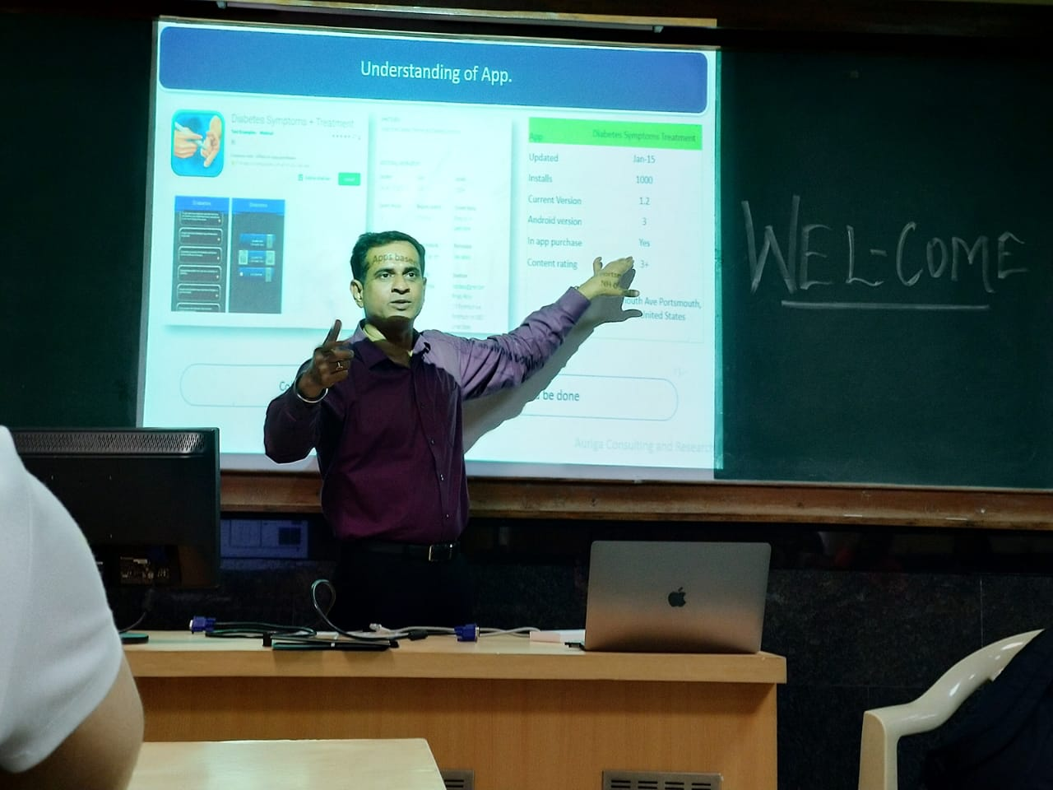
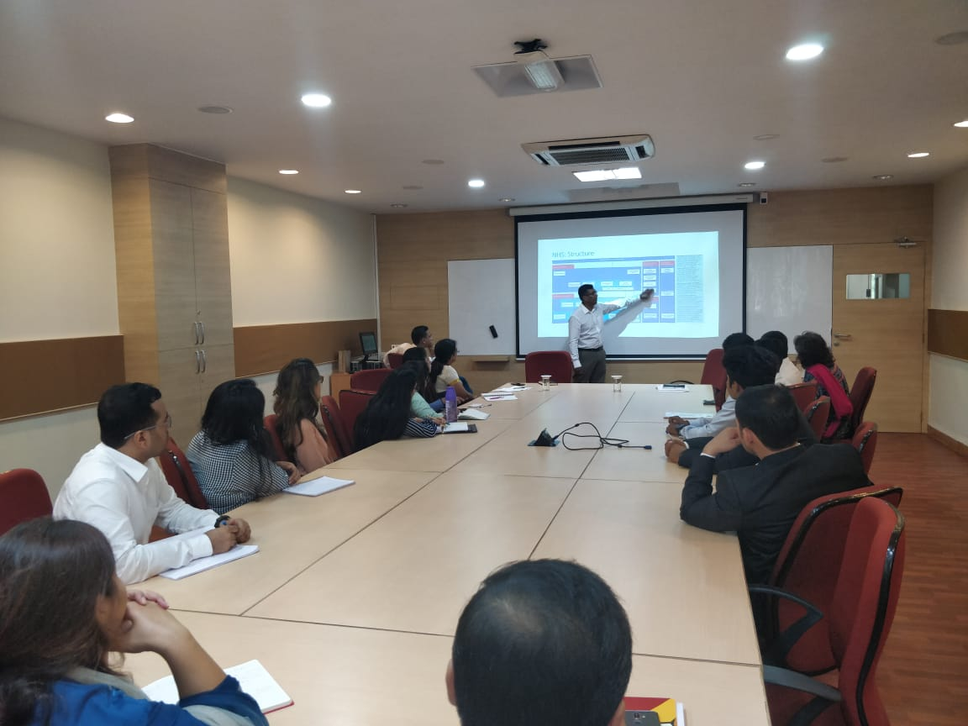
Emphasis on Experiential Learning

Slide 17
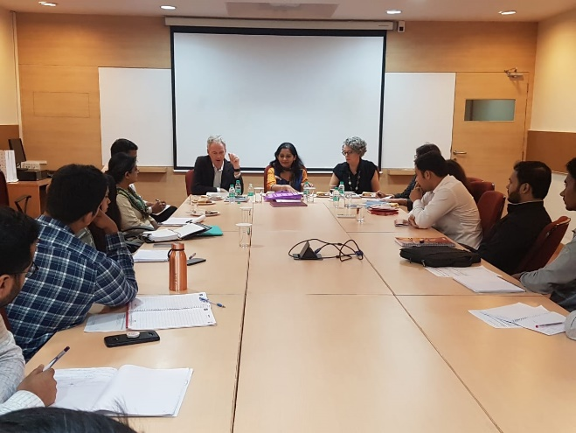
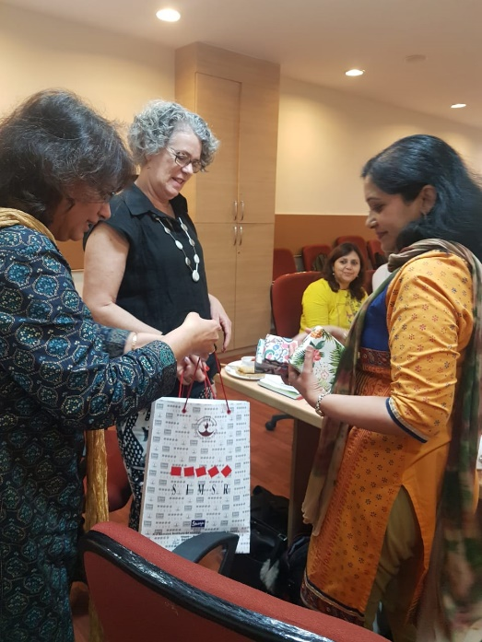
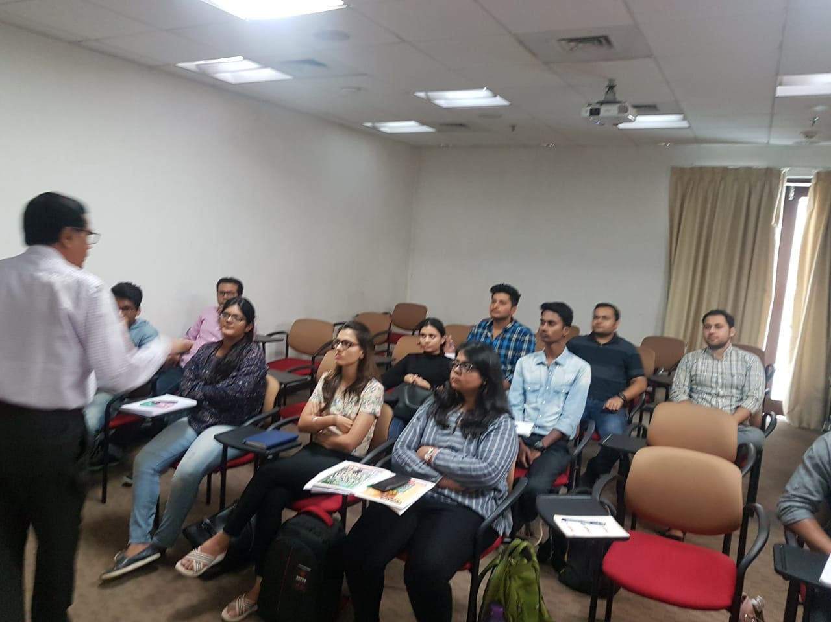
Emphasis on Experiential Learning

Slide 18
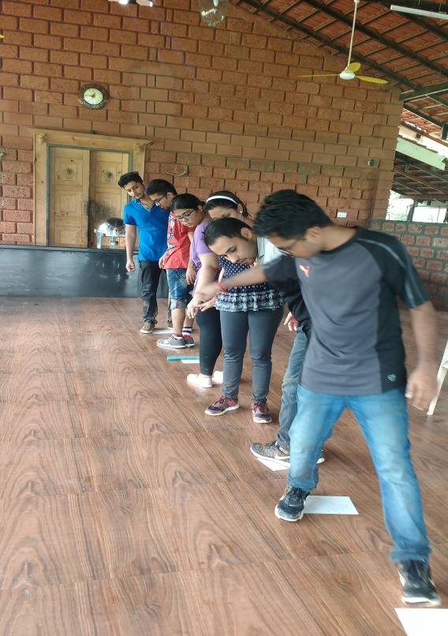
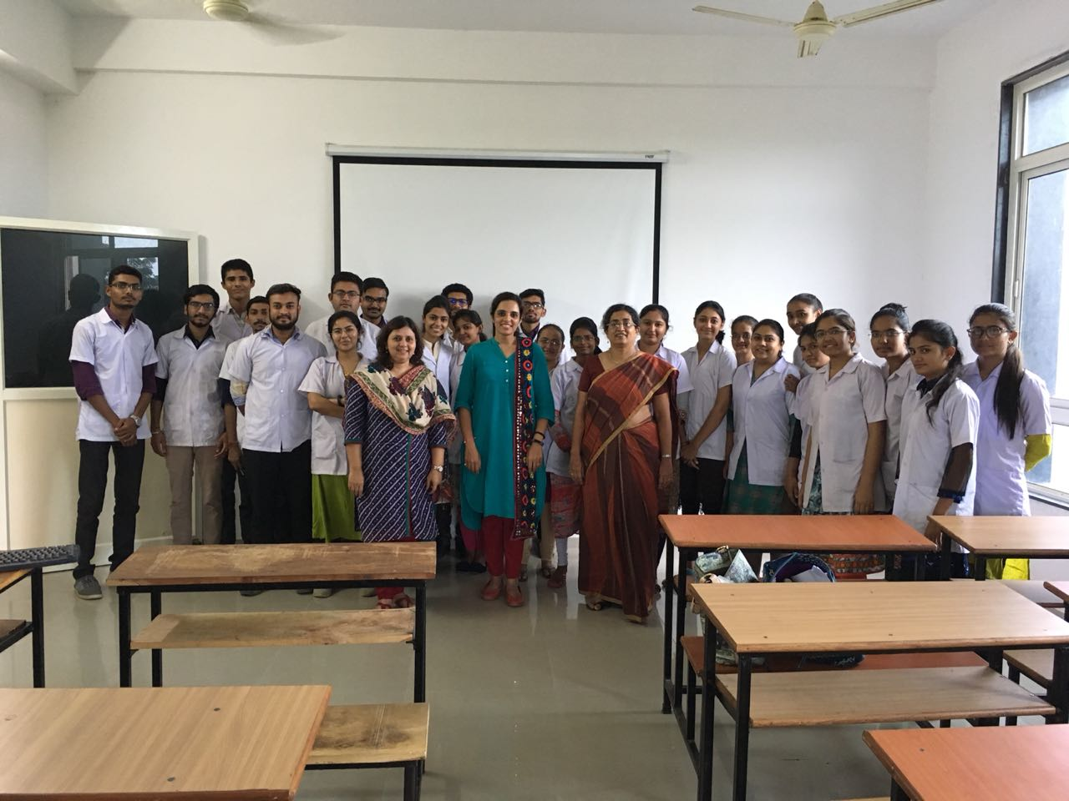
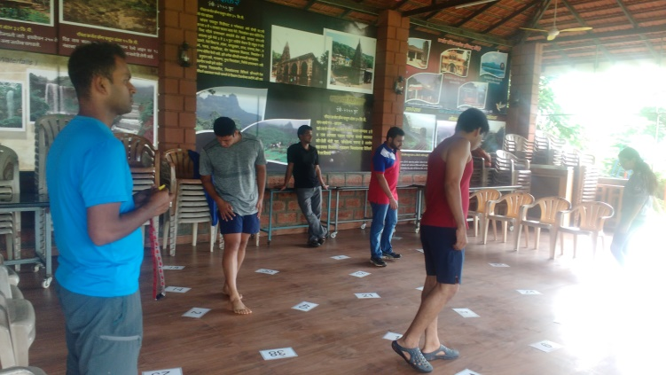
Emphasis on Experiential Learning

Slide 19
Industrial visits organized in the past
1. Wipro-GE Healthcare India, Bangalore
2. Thyrocare Technologies, Navi Mumbai
3. Draeger India Pvt. Ltd
4. Mazumdar Shaw Medical Foundation – Bangalore
5. Jupiter Hospital, Mumbai

Slide 20
Summer Internships of Healthcare Management Students
Apollo Hospital
Health Coco Technologies Pvt Ltd
Thermo Fisher
PharmaLab
Kaipro
Kokilaben Ambani Hospital
Jupitor Hospital
Godavari Biorefineries
Venkys India Pvt Ltd
Tata Steels Pvt Ltd
Healthism
Future Generali India life Insurance
IPCA Laboratories Ltd
Deloitte Touche Tohmatsu LLP
A1 Hi-tech Healthcare Solutions
Unschool
MBAtrek
Terumo India Pvt Ltd
Shira Medtech

Slide 21
Live Projects/ Concurrent Projects
K J Somaiya Hospital & Research Centre
Hygienic Research Institute Pvt. Ltd
Pop Shot
RK Foodland
Supermark Agency
Flywidus
McVitie’s (pladis Global)
Viden.io
Quezapp Technologies Pvt. Ltd.
Red Brick Offices
Medito foundation
Urban liveability Forum
Suvidha Infoserve Private Ltd.
Cart Geek
Udyam Gyan
Zillionite
A&O Realty
Organic Riot
Britannia Industries Ltd.
Tata Centre for Technology & Design
Wadhwa Group
Scholastic Scholar
Nessbot
Aratrikam Business Services

Slide 22
Live Projects/ Concurrent Projects
Jio Creative Labs
Fitternity
IndusInd Bank
Benetton
B D Shah securities Ltd
IFA Global
Future Group
The Times Group
Kraftshala
Bisleri
Artophilic
Exlygenze Senseworks PLC
Zoom car
House of Makeup
Religare Health insurance
Wadhwa Group
Trariti Consulting
Local Vocal
Rupezeen
Accurex
Shemaroo
Counsel Lab
Ather Energy

Slide 23
Final Placements ( first Batch PGDM 2018-20)
Fitternity
Wipro Ltd
Byjus.com
Tilt Bike
Atticus Advisors
Byte Dance India Technology(Tik-Tok)
Amrop
Adani Wilmer

Slide 24
Admission Process and Selection Criteria
The interested candidates need to apply through the regular admission process specified on the website.
They need to appear for one of the MBA entrance test mentioned on the website.
The shortlisted candidates will be asked for further admission process of GDPI round.
The selection for the MBA HCM programme will be based on the candidate’s profile – relevant undergraduate degree, relevant work experience, interest areas, etc.

Slide 25
Conferences Organized in the Past
2019 – Healthcare 4.0 – Myths & Realities
Chief Guest – Mr Srinivas Madubusy - Director, Merck Specialities Pvt. Ltd
Panel Members - Mr. Venkatram V, VP Finance, Apollo Hospitals, Navi Mumbai
Mr. Gaurav Patel, HR -Roche
Dr. Urmila Joshi, Principal, K M Kundanani College of Pharmacy, Colaba
Mr. Prayat Shah, Co-founder and VP enterprise Sales, Wellthy Therapeutics
Ms Sanju Yadav, Divisional Head – Sales and Marketing
Moderator – Mr Sachin Parekh

Slide 26
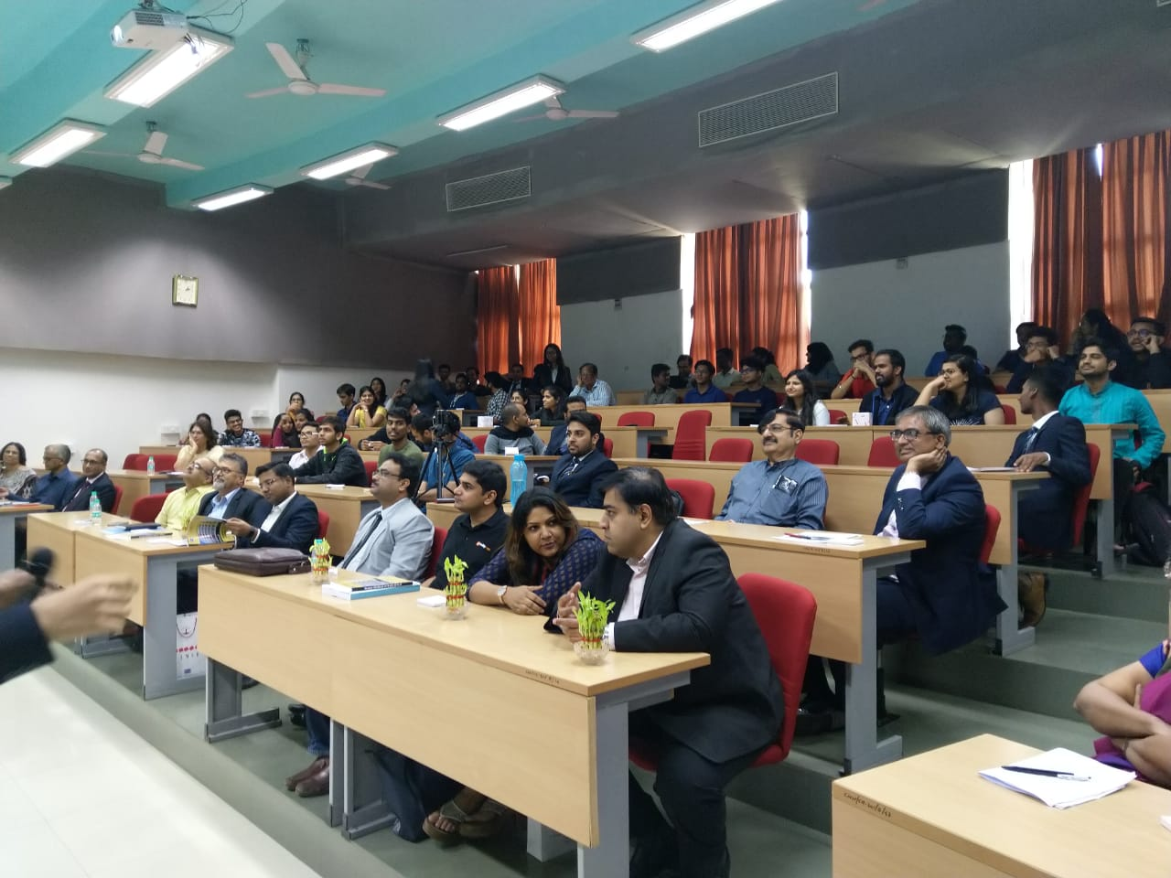
Round Table Conference 2019

Slide 27
Conferences Organized
2020 – Reaching the Last Mile; Opportunities & Challenges
Chief Guest – Dr A Velumani, Chairman & MD Thyrocare Technologies
Panel Members – Dr Praveen Swamy, CEO, Godrej Memorial Hospital,
Ms Rashmi Thosar, CEO Brandcare,
Mr Subodh Gupta, Founder & CEO ReLiva Physiotherapy & Rehab
Moderator - Ms Anagha Shirur, Associate Marketing Manager, Novartis
Proposed
2021 – 1st International Healthcare Management – Future of Healthcare Post COVID 19 to be organized on 9th January 2021

Slide 28
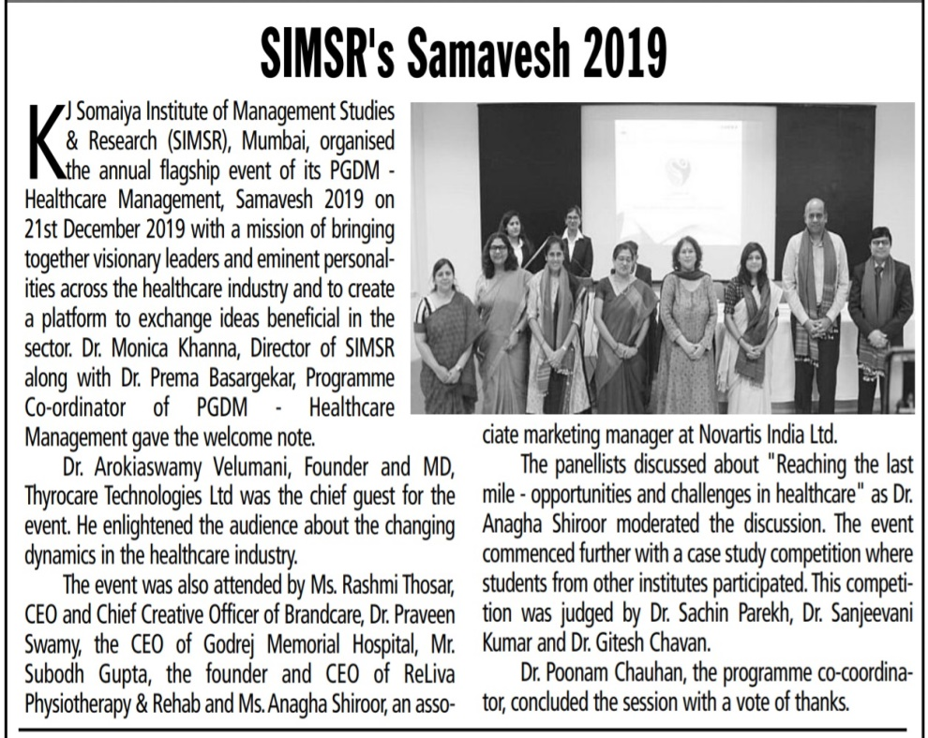
Round Table Conference 2020

Slide 29
Webinars Organized
Webinars and Guest Lectures:
Webinars:
1) 28th June 2020 - Challenges and Opportunities for the Healthcare Sector Post COVID :
Dr. Pramod Prabhakaran, Jamshyd Patravala, HCM Board of Studies Members
2) 12th July, 2020 - Role of Data Informatics and Communication in fighting COVID
Panel Members: Ayush Shukla - CM Fellow - working on fighting CORONA with Govt of Maharashtra, Jamshyd Patrawala - Sr Healthcare leader, Harish Rijhwani - Healthcare Data Analytics Specialist and Dr. Pramod Prabhakaran - Imperial College Health Partners, UK – Moderator

Slide 30
Course List - Trimester I
 | Trimester I
 | Courses | Marks
 | Courses (Management)
1 | Business Communication & Report Writing | 100
2 | Statistical Analysis | 100
3 | Fundamentals of Health Economics | 100
4 | IT in Management | 100
5 | Fundamentals of Finance | 100
6 | Fundamentals of Marketing | 100
7 | Organizational Behaviour | 100
 | Courses (Technical)
8 | Epidemiology | 100
 | Total | 800

Slide 31
Course List - Trimester II
Trimester II
Sr. No. | Courses | Marks
 | Courses (Management)
1 | Research Methodology | 100
2 | Healthcare Services Management | 100
3 | Macroeconomic Aspects of Health Sector | 100
4 | Supply Chain Management | 100
5 | HRM | 100
6 | Cost & Managerial Accounting | 100
 | Courses (Technical)
7 | Pharma and Biotech Management | 100
8 | Hospital Administration | 100
 | Total | 800

Slide 32
Course List - Trimester III
 | Trimester III
Sr No. | Courses | Marks
 | Courses (Management)
1 | Healthcare in Rural Markets | 100
2 | Financial Management | 100
3 | Quality Management in Healthcare | 100
4 | Medico-Legal Environment in Healthcare | 100
5 | Facility Management | 100
6 | IT Application in Healthcare | 100
7 | Healthcare Marketing (Pharma, Hospitals, Medical Devices, Wellness) | 100
 | Courses (Technical)
8 | Patient Care and Behaviour | 100
 | Total | 800

Slide 33
Course List - Trimester IV
 | Trimester IV
Sr No. | Courses | Marks
 | Courses (Management)
1 | Retail Management in Healthcare | 100
2 | Business Development in HealthCare | 50
3 | Leadership Lab | 50
4 | Strategic Brand Management | 100
5 | Entrepreneurship Management | 100
6 | Demographic Analysis & Policy for Healthcare | 50
 | Courses (Technical)
7 | Health Insurance & Financing | 100
8 | International Business & Marketing (Medical Tourism) | 100
9 | Counselling | 50
10 | Intellectual Property Right (IPR) | 50
11 | Design Thinking | 50
12 | Summer Internship Project | 100
 | Total | 800 +100 (W) = 900

Slide 34
Course List - Trimester V
 | Trimester V
Sr No. | Courses | Marks
 | Courses (Management)
1 | Integrated Marketing Communications (IMC ) | 50
2 | Data Analytics for Healthcare | 100
3 | Competitive Strategic Management | 100
4 | Market Research | 50
5 | Digital Marketing | 100
6 | Taxation | 50
 | Courses (Technical)
8 | Environmental Health and Safety Management | 50
9 | Emerging Technologies in Healthcare | 50
10 | Six Sigma in Healthcare | 50
 | Total | 500 +100 (W) = 600

Slide 35
Course List - Trimester VI
 | Trimester VI
Sr No. | Courses | Marks
 | Courses (Management)
1 | Performance Mgt Systems & Compensation | 100
2 | Sustainable Healthcare (WHO) | 50
3 | Customer Relationship Management | 100
4 | Ethics in Healthcare Management | 50
5 | NGO Management | 50
6 | Master Thesis | 100
 | Courses (Technical)
7 | Biomedical Waste Management | 50
8 | Risk & Disaster Management | 100
9 | Alternative Medicines | 50
10 | Advanced Data Analytics in Healthcare | 50
 | Total | 600 +100 (W) = 700

Slide 36
Career Opportunities
Hospital Administration
Digital Healthcare
Digital Marketing of Healthcare
Sales and Marketing of Healthcare Products And Services
HR Management Inn Healthcare Sector
Operations And Supply Chain Management In Healthcare
Healthcare Advertising And Media Management
Health Insurance

Slide 37
Career Opportunities
Product Management In Healthcare
Patient Care And Support Management
Financial Management In Healthcare
Managing Healthcare Chains
Data Analytics And Informatics In Healthcare
Quality Management
Consultancy In Healthcare
New Business Development In Healthcare

Slide 38
Thank You
simsr.somaiya.edu

